Slide 1
Layer 1 - Physical Layer : Overview
This layer defines the electrical, mechanical, procedural, and functional specifications for activating, maintaining, and deactivating the physical link between end to end systems.
Such characteristics as listed below are defined by physical layer specifications.
    voltage levels
    timing of voltage changes i.e. bit times
    physical data rates
    maximum transmission distances
    physical connectors

Slide 2
Most Common LAN Media
STP (Shielded Twisted Pair)
UTP (Unshielded Twisted Pair)
Coaxial cable
Optical fibre
Wireless communication

Slide 3
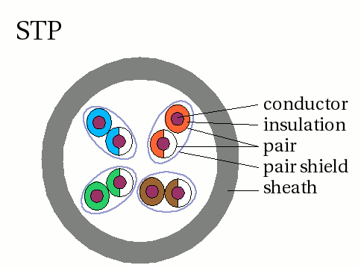
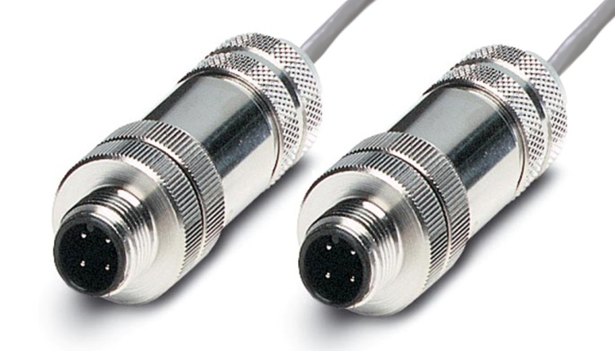
Shielded Twisted Pair (STP)
STP uses shielding, cancellation, and twisting of wires to protect against electromagnetic and radio frequency interference.
Throughput: 10-100 Mbps
Moderately expensive … more expensive than UTP
Media connector size can be large (eg. IBM UDC)
Max. cable length is 100m
Cable needs to be grounded at both ends

Slide 4
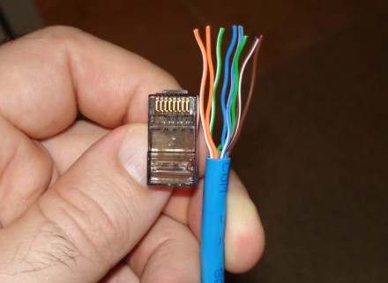
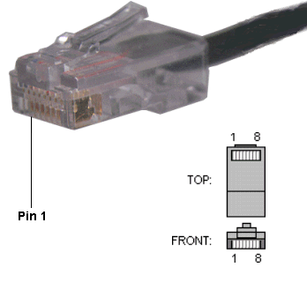
Unshielded Twisted Pair (UTP)
UTP relies solely on cancellation and twisting of wires
Throughput: 10 -100 Mbps
Least expensive
Media connector size is small
Max. cable length is 100m
Easy to install due to small external diameter

Slide 5
Cable Specification Standards
Many proprietary standards had evolved by the mid 1980s
Standards were developed to try to ensure inter-operability amongst different manufacturers equipment
The following organisations issue standards for networking media:
  IEEE - Institute of Electrical & Electronics Engineers
  UL - Underwriters Laboratories
  EIA - Electrical Industries Association
  TIA - Telecommunications Industries Association
Other specifications and requirements issued by, local, state, county, and national government agencies can impact the type of cabling that can be used in a local area network.

Slide 6
The EIA & TIA Standards
The EIA & TIA have had the greatest impact on networking media standards
The EIA & TIA issue a list of joint standards (TIA/EIA standards).
They specify the minimum requirements for multi-product and multi-vendor environments.
They allow for the planning and installation of LAN systems without dictating the use of specific equipment.

Slide 7
TIA/EIA Standard 568 specifies different "categories" of Unshielded Twisted Pair UTP cabling systems (wires, junctions, and connectors) in terms of the data rates that they can sustain.
The specifications describe the cable material as well as the types of connectors and junction blocks to be used in order to conform to a category. These categories are:

Slide 8
Category | Maximum Data Rate | Usual Application
CAT 1 | Less than 1 Mbps | Analogue Voice (POTS) Integrated Service Digital Network (ISDN) Doorbell wiring!
CAT 2 | 4 Mbps | IBM token ring networks
CAT 3 | 10 Mbps at 100m | Voice and Ethernet
CAT 4 | 10-12 Mbps | not used very much today
CAT 5 | up to 256 Mbps depending on distance | Fast Ethernet Most used type today.
CAT 6 | GigaByte | GigaByte Ethernet
Notes:
Category 3 Cables
Category 3 cables have been in common use in networks used for ethernet on twisted pair for many years. The cable design has limited their operation to 10 megabit per second data transmission.

Slide 9
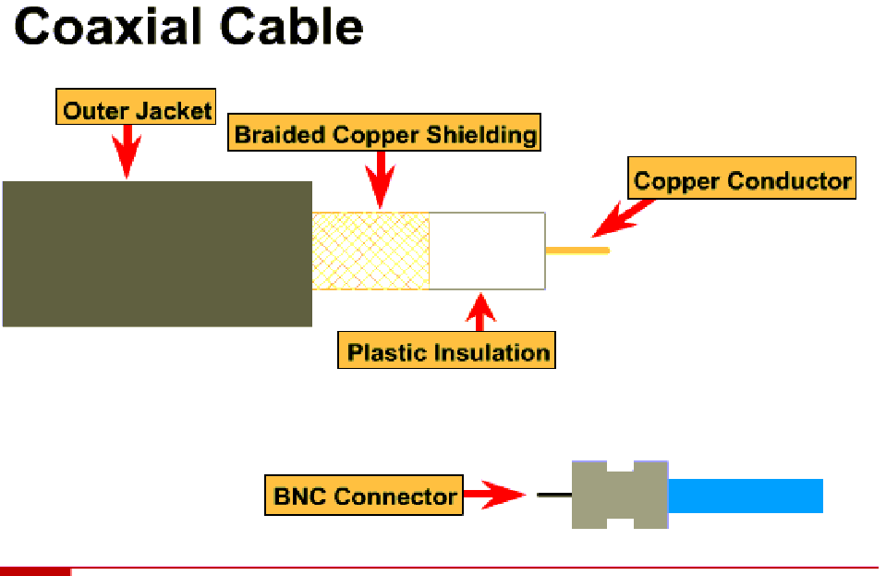
Coaxial Cable
Inner copper conductor surrounded by a layer of flexible insulation. Over this is a metallic foil that acts as the second wire in the circuit, and as a shield for the inner conductor. Covering this shield is the cable jacket.
Throughput: 10-100 Mbps
Inexpensive
Media connector size: medium
Max. cable length: 500m

Slide 10
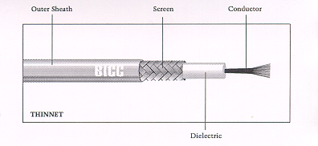
Coaxial Cable
Coaxial
Notes:
Coaxial cables
Coaxial cable was for many years the most popular media for LANs. This was mainly due to the large uptake of Ethernet-based LANs. Data travels via the two conductors that share the same axis (co=together, axial = central pivot). The end of the cable is attached via a suitable connector (usually a BNC- bayonet style connector) which is commonly crimped to the conductors. This type of cable is capable of carrying transmissions in the order of 200 MHz and potentially data at 100s of megabits per second. However, it is commonly used in networks that support data transmission at 10 Mbps (Ethernet).

Slide 11
Coaxial Cable
Coaxial cable comes in a variety of sizes
The largest, known as thicknet or 10Base5, was generally used in Ethernet networks as the backbone cable. Could cover distances up to 500m
A much thinner diameter cable, known as thinnet or 10Base2 was also used in Ethernet networks. Much easier to install than thicknet. Could cover distances up to 185m

Slide 12
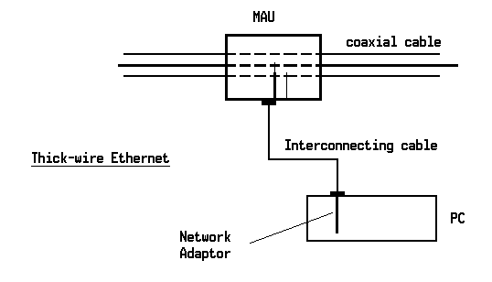
Thick Coaxial Cable attachment
Notes:
Thick-wire Ethernet (IEEE802.3, 10BASE5)
An integrated tap and transceiver unit (medium access unit - MAU) is clamped to
the cable. This MAU is then attached to the NIC via an AUI (attachment unit to
interface) cable which carries the send and receive data as well as power for the
transceiver and the collision detect signal pair from the transceiver.

Slide 13
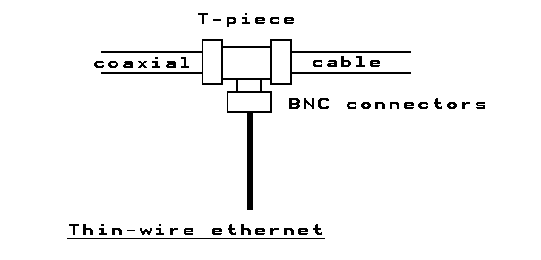
Thin Coaxial Cable attachment
Notes:
Thin-wire Ethernet (IEEE802.3, 10BASE2 - "cheapernet")
Thin wire cable is laid around to each network node which is attached via
a T-piece (a T-shaped connector, BNC type - bayonet).
The arm of the T passes the signal through to permit all nodes to be attached to
the one linear run of cable, whilst the post of the T attaches to a BNC
connector on the rear of the network interface.
The MAU component is included in the construction of the communications
controller.

Slide 14
Some Ethernet Terminology
MAU = Medium Attachment Unit - can be a BNC T-piece or a ‘vampire tap’.
10base2 = signaling speed in Mbps, transmission method (baseband or broadband),maximum number of meters that the cable can be, rounded to the nearest 100m and divided by 100.
We have 10Base5, 10BaseFL - multi mode fibre optic,10BaseT - twisted pair.

Slide 15
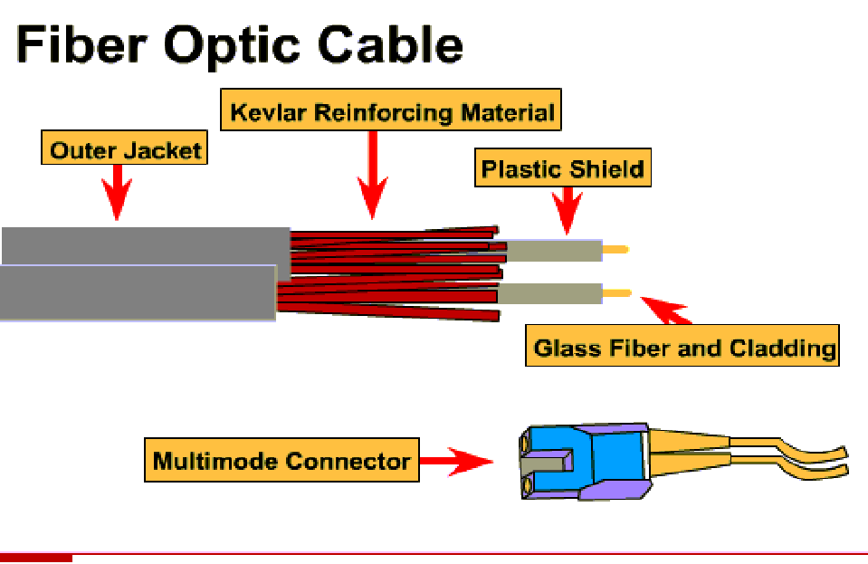
Fibre Optic Cable
Fibre-optic cable is a medium capable of conducting light transmissions and is immune to EMI & RFI interference.
Throughput: 1000+ Mbps
Most expensive medium
Media connector size: small
Max cable length: 2 Km
Single mode: One stream of laser generated light.
Multimode: Multiple streams of LED generated light.

Slide 16
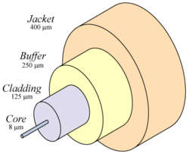
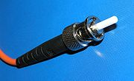
Fibre Optic Cable construction
ST Connector

Slide 17

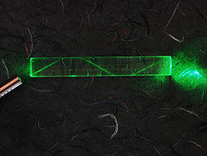
Fibre Optic Cable Transmission
Laser in block of plastic

Slide 18
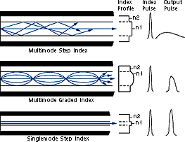
Fibre Optic Cable Media Types
Notes:
Fibre Construction
Fibre optic cables are of three main types of construction.
Multi-mode step index fibre which is the fibre that largely passes light due to reflection and is the cheapest to manufacture.
Multi-mode graded index fibre where the transmission is by reflection and refraction. Here the light is not only reflected by the outer surface of the fibre, but is also refracted (bent) within the fibre in the same way a prism bends light.
Single mode step index fibre where transmission is only via parallel paths from transmitter to receptor. This is the fibre that can carry data at the highest speeds (Gbps and up) over the longest distances (20 Kms being common).

Slide 19
Optical Fibre Capabilities
Over short distances, fibre saves space in cable ducts because a single fibre can carry much more data than a single electrical cable. fibre is immune to electrical interference; there is no cross-talk between signals in different cables and no pickup of environmental noise.
Non-armoured fibre cables do not conduct electricity, which makes fibre a good solution for protecting communications equipment located in high voltage environments such as power generation facilities, or metal communication structures prone to lightning strikes. They can also be used in environments where explosive fumes are present, without danger of ignition. Wiretapping is more difficult compared to electrical connections, and there are concentric dual core fibres that are said to be tap-proof.
Although fibres can be made out of transparent plastic, glass, or a combination of the two, the fibres used in long-distance telecommunications applications are always glass, because of the lower optical attenuation. Both multi-mode and single-mode fibres are used in communications, with multi-mode fibre used mostly for short distances (up to 550m), and single-mode fibre used for longer distance links. Because of the tighter tolerances required to couple light into and between single-mode fibres (core diameter about 10 micrometers), single-mode transmitters, receivers, amplifiers and other components are generally more expensive than multi-mode components.

Slide 20
Optical Carrier | Data Rate (bps)
OC-1 | 51,840
OC-3 | 155,520
OC-12 | 622,080
OC-24 | 1,244,160
OC-48 | 2,488,320
OC-192 | 9,953,280
OC-768 | 39,813,120
OC-3072 | 159,252,240 = 159Gbps (approx. 30 CDs per second)

Slide 21
Wireless Communication
Wireless signals are electromagnetic waves, which can travel through the vacuum of outer space and through media such as air.
Therefore, no physical medium is necessary for wireless signals, making them a very versatile way to build a network.

Slide 22
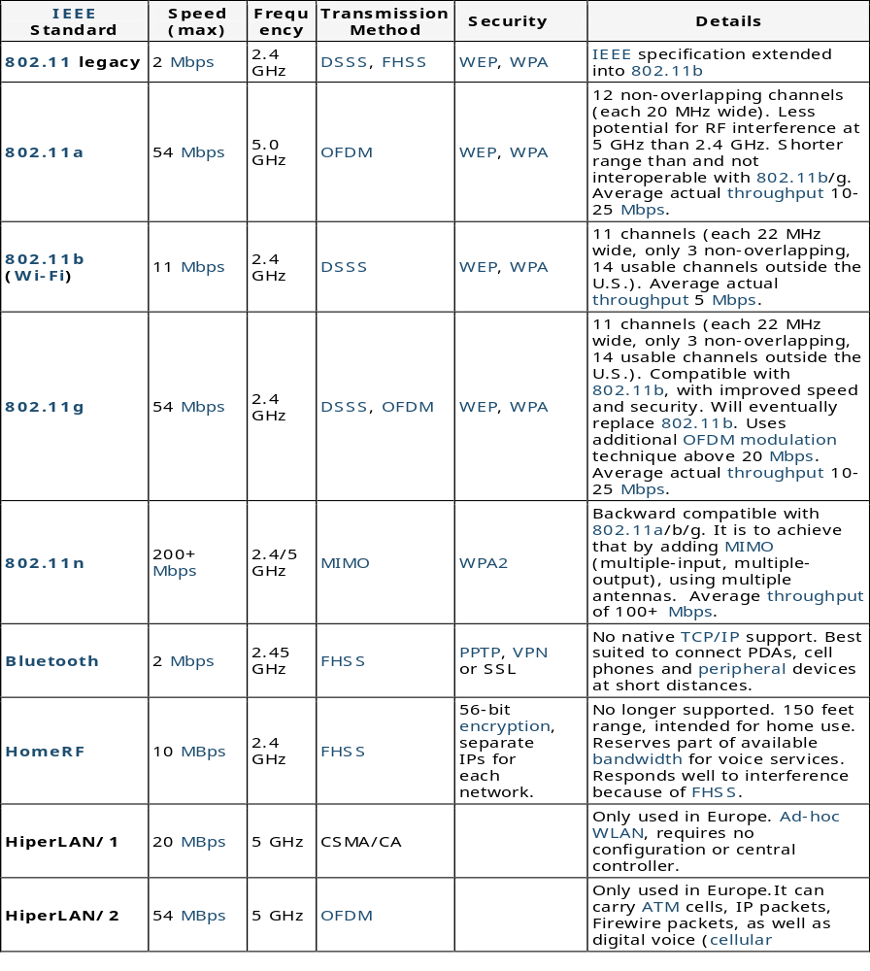
IEEE Standards
Signalling Method
FHSS : frequency hopping
spread spectrum
DSSS : direct
spread spectrum
sequence
OFDM : orthogonal
frequency division
multiplexing
MIMO : multiple input
Multiple output
(see notes)
Notes:
Frequency Hopping Spread Spectrum - FHSS
FHSS radio uses the frequencies from 2.4GHz to 2.4835GHz, a bandwidth of 83.5MHz. It uses 2 and 4 level Frequency Shift Keying (FSK) and divides the total bandwidth into 79 channels of 1MHz each. It then hops between all of these channels in one of 78 orthogonal (non colliding) patterns. This makes it possible to have approximately 15 access points in an area before interference occurs. The downside is that this technique has a rather low throughput and shorter range than Direct Sequence Spread Spectrum. The standard says 2Mbps maximum but there are products that are capable of 3Mbps (proprietary).
Direct Sequence Spread Spectrum (DSSS)
Direct Sequence Spread Spectrum uses the radio frequencies ranging from 2.4 to 2.4835MHz (83.5MHz bandwidth). It uses a Differential Binary Phase Shift Keying (DBPSK) and Differential Quadruple Phase Shift Keying (DQPSK) modulation and divides the total bandwidth into 13 channels (11 channels in the USA and "World Mode" and 14 channels in Japan). When configured, the radio stays on the selected channel. The term "spread spectrum" is used because the radio uses several frequencies at once.

